Slide 1
Course
AWS Cloud Practitioner
MaxCloud

Slide 2
12
Class
AWS Well Architect Framework
AWS CAF
AWS SNOW FAMILY

Slide 3
AWS Well-Architected Framework
Creating a software system is a lot like constructing a building. If the foundation is not solid, structural problems can undermine the integrity and function of the building.
When architecting technology solutions, if you neglect the six pillars of operational excellence, security, reliability, performance efficiency, cost optimization, and sustainability, it can become challenging to build a system that delivers on your expectations and requirements.
Incorporating these pillars into your architecture will help you produce stable and efficient systems. This will allow you to focus on the other aspects of design, such as functional requirements.

Slide 4
The pillars of the framework
Operational excellence
Security
Reliability
Performance efficiency
Cost optimization
Sustainability
https://docs.aws.amazon.com/wellarchitected/latest/framework/welcome.html

Slide 5
An Overview of the AWS Cloud Adoption Framework
As the proliferation of digital technologies continues to disrupt market segments and industries, adopting Amazon Web Services (AWS) can help you transform your organization to meet the changing business conditions and evolving customer needs.
As the world’s most comprehensive and broadly adopted cloud platform, AWS can help you lower costs, reduce business risks, improve operational efficiency, become more agile, innovate faster, create new revenue streams, and reinvent customer and employee experience.

Slide 6
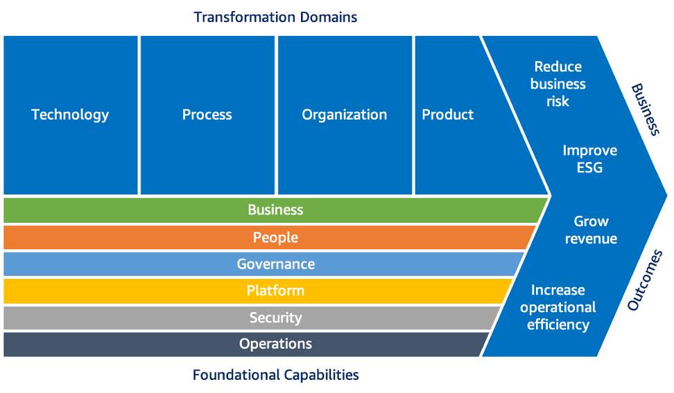
An Overview of the AWS Cloud Adoption Framework

Slide 7
Pregunta 1
Which of the two design principles below relates to the “Operational Excellence” pillar of the Well-Architected framework? (Choose 2)
A. Implement a strong identity foundation
B. Enable traceability
C. Anticipate Failure
D. Manage change in automation
E. Perform operations as code

Slide 8
Pregunta 1
Which of the two design principles below relates to the “Operational Excellence” pillar of the Well-Architected framework? (Choose 2)
A. Implement a strong identity foundation
B. Enable traceability
C. Anticipate Failure
D. Manage change in automation
E. Perform operations as code

Slide 9
Pregunta 1
Which of the two design principles below relates to the “Operational Excellence” pillar of the Well-Architected framework? (Choose 2)
A. Implement a strong identity foundation
B. Enable traceability
C. Anticipate Failure
D. Manage change in automation
E. Perform operations as code

Slide 10
Pregunta 2
Which pillar of the AWS Well-Architected Framework refers to the ability of a system to recover from infrastructure or service disruptions and dynamically acquire computing resources to meet demand?
A. Security
B. Reliability
C. Performance efficiency
D. Cost optimization

Slide 11
Pregunta 2
Which pillar of the AWS Well-Architected Framework refers to the ability of a system to recover from infrastructure or service disruptions and dynamically acquire computing resources to meet demand?
A. Security
B. Reliability
C. Performance efficiency
D. Cost optimization

Slide 12
Pregunta 3
Which perspective in the AWS Cloud Adoption Framework (AWS CAF) includes capabilities for configuration management and patch management?
A. Platform
B. Operations
C. Security
D. Governance

Slide 13
Pregunta 3
Which perspective in the AWS Cloud Adoption Framework (AWS CAF) includes capabilities for configuration management and patch management?
A. Platform
B. Operations
C. Security
D. Governance

Slide 14
AWS Snow Family
AWS SNOWCONE
AWS SNOWBALL EDGE STORAGE OPTIMIZED 80 TB
AWS SNOWBALL EDGE STORAGE OPTIMIZED 210 TB
AWS SNOWBALL EDGE COMPUTE OPTIMIZED
AWS SNOWMOBILE

Slide 15
Muchas Gracias

